Slide 1

Database Fundamentals

Slide 2








Course Content
DBMS Overview
ER Diagram Normalization
Index
Constraints
SQL -DML, DDL, DQL
Sub query and Joins

Slide 3
DBMS Overview
INTERNAL

Slide 4


DBMS
A database is an organized collection of structured information or data
stored in a computer system.
A database is usually controlled by a DBMS.
Database Management Systems (DBMS) are software systems used to store, retrieve, and run queries on data.
A DBMS serves as an interface between an end-user and a database.
DBMS
DB

Slide 5
RDBMS
A Relational database management system (RDBMS) is a database
management system (DBMS) that is based on the relational model.
Examples
SQL
MS SQL Server
PostgreSQL
ORACLE
My-SQL
Microsoft Access, etc..

Slide 6
Terminologies
Schema
Table or Relation
Rows or Record or Tuple
Column or Field or Attribute
Data value

Slide 7
Schema and Table
Schema
Schema is a collection of one or more tables of data.
Table/Relation
The RDBMS database uses tables to store data.
A table is a collection of related data entries and contains rows and columns to store data.
Each table represents some real-world objects such as person, place, or
event about which information is collected.
Customer_Id | Customer_Name | Age | Location
01 | Ajeet | 24 | India
02 | Ratan | 20 | China
03 | Lai | 36 | Singapore
04 | Aaryan | 32 | Taiwan

Slide 8
Rows, Columns and Data
Rows / Record / Tuple
- a single group of related data within a table
Customer_Id | Customer_Name | Age | Location
01 | Ajeet | 24 | India
Row
Columns / Field / Attribute
A column is a list of values, usually belonging to a particular field, displayed
vertically in a table.
In Customer table, Customer_Id, Customer_Name, Age and Location are the columns
Customer_Id | Customer_Name | Age | Location
01 | Ajeet | 24 | India
02 | Ratan | 20 | China
03 | Lai | 36 | Singapore
Data / Value - information which database just stores.

Slide 9
ER Model and ER Diagram
The ER Model is a model for identifying entities to be represented in the database and representation of how those entities are related.
ER diagrams are used to represent the ER model in a database, which makes them easy to convert into relations (tables).
It is used to analyze to structure of the Database.
It shows relationships between entities and their attributes.

Slide 10
ER Diagram
INTERNAL
ER Diagram

Slide 11
Symbols used in ER Model
Rectangles: Rectangles represent Entities in the ER Model.
Ellipses: Ellipses represent Attributes in the ER Model.
Diamond: Diamonds represent Relationships among Entities.
Lines: Lines represent attributes to entities and entity sets with other relationship types.

Slide 12
Example
In Loan Management,
Entities : customer and loan
Attributes : Customer_Id, Name, Age, Loan_Id and Type
Relation: Borrower
Age
Name
Loan_Id
Customer_Id
Type
Customer
borrower
Loan

Slide 13
Normalaization
Normalization

Slide 14
Normalization
Normalization is the process of organizing the data in the database.
Normalization is used to minimize the redundancy from a relation or set of relations.
It is also used to eliminate undesirable characteristics like Insertion, Update, and Deletion Anomalies.
Normalization divides the larger table into smaller and links them using relationships.

Slide 15
Normal Forms
Normal forms are used to eliminate or reduce redundancy in database tables.
In database management systems (DBMS), normal forms are a series of guidelines that help to ensure that the design of a database is efficient, organized, and free from data anomalies. There are several levels of normalization, each with its own set of guidelines, known as normal forms.

Slide 16
First Normal Form (1NF)
A relation will be 1NF if it contains an atomic value.
It states that an attribute of a table cannot hold multiple values. It must hold only single-valued attribute.
First Normal Form (1NF) does not eliminate redundancy, but rather, it’s that it
eliminates repeating groups
Employee Table without 1NF
Employee Table with 1NF
Emp_Id | Emp_Name | Emp_Phone
14 | John | 7273445698, 9064738238
20 | Harry | 8574783832
12 | Sam | 7390372389, 8589830302
Emp_Id | Emp_Name | Emp_Phone
14 | John | 7273445698
14 | John | 9064738238
20 | Harry | 8574783832
12 | Sam | 7390372389
12 | Sam | 8589830302

Slide 17
Second Normal Form (2NF)
A table is said to be in 2NF, if
The table meets all the conditions of 1NF
Move redundant data to a separate table
Create relationship between these tables using foreign keys.
Employee – Dept table after 1NF
Emp_Id | Emp_name | Salary | Dept_name | Location
101 | Aarav | 25000 | IT | India
102 | Sarah | 30000 | HR | China
103 | Tyra | 40000 | HR | China
104 | Lai | 35000 | IT | India
Employee Table after 2NF
De Dept_Id | pt Table after Dept_Name | 2NF Loaction
201 | IT | India
202 | HR | China
Emp_Id | Emp_Name | Dept_Id
101 | Aarav | 201
102 | Sarah | 202
103 | Tyra | 202
104 | Lai | 201
*we need to break the table into 2, and move the redundant department data (DeptName, and Location) into it's own table. To link the tables with each other, we use the DeptId foreign key. The tables below are in 2NF.

Slide 18
Third Normal Form (3NF)
Employee table
Emp_Id | Emp_name | Salary | Annual_salary | Dept_Id
101 | Aarav | 25000 | 300000 | 201
102 | Sarah | 30000 | 360000 | 202
103 | Tyra | 40000 | 480000 | 202
104 | Lai | 35000 | 420000 | 201
A table is said to be in 3NF, if the table
Meets all the conditions of 1NF and 2NF
Does not contain columns (attributes) that are not fully dependent upon the primary key
Employee Table after 2NF
De Dept_Id | pt Table after Dept_Name | 2NF Loaction
201 | IT | India
202 | HR | China
Emp_Id | Emp_Name | Dept_Id
101 | Aarav | 201
102 | Sarah | 202
103 | Tyra | 202
104 | Lai | 201
*The AnnualSalary is also dependent on the Salary column. In fact, to compute the AnnualSalary, we multiply the Salary by 12. Since AnnualSalary is not fully dependent on the primary key, and it can be computed, we can remove this column from the table, which then, will adhere to 3NF.

Slide 19
Indexing
Indexing

Slide 20
Index
An index in SQL Server is a data structure associated with a table or view
Index speeds up the retrieval of rows from the table based on the values in one or more columns.
Indexes are put internally and are not visible to the user.
There are two types of databases indexes:
Clustered
Non-clustered

Slide 21
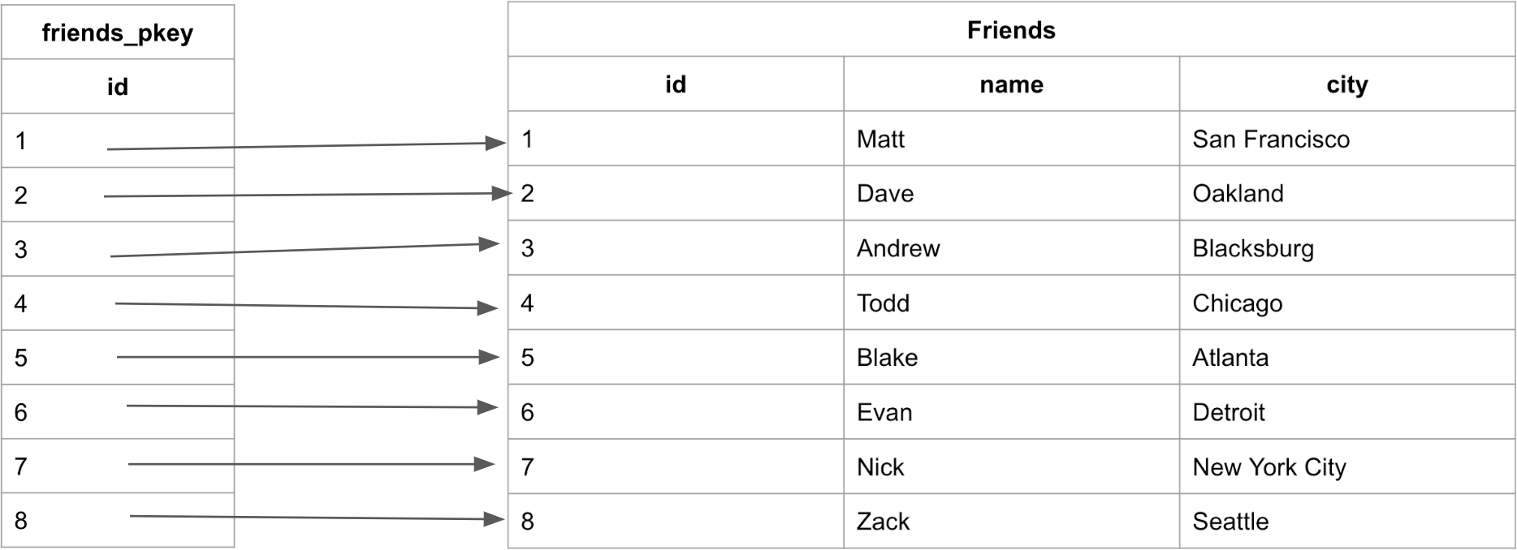
Clustered Index
Clustered indexes are the unique index per table that uses the primary key to organize the data that is within the table.
The clustered index ensures that the primary key is stored in increasing order, which is
also the order the table holds in memory.
Clustered indexes do not have to be explicitly declared.
Created when the table is created.
Use the primary key sorted in ascending order.

Slide 22
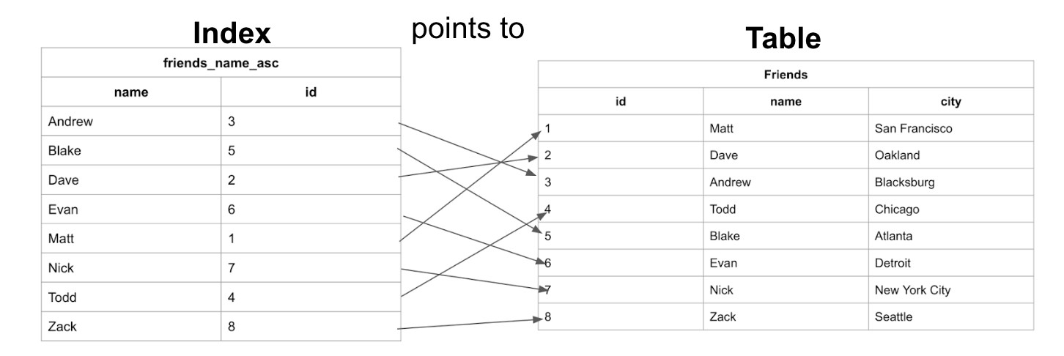

Non Clustered Index
Non-clustered indexes are sorted references for a specific field, from the main table, that hold pointers back to the original entries of the table.

Slide 23

When Should Indexes be Created?
INTERNAL
A column contains a wide range of values.
A column does not contain a large number of null values.
One or more columns are frequently used together in a where clause
or a join condition.
We can see here that the table has the data stored ordered by an incrementing id based on the order in which the data was added. And the Index has the names stored in alphabetical order.

Slide 24
PostgreSQL
Postgesql

Slide 25
Overview of PostgreSQL
PostgreSQL, also known as Postgres, is a free and open-source relational database management system (RDBMS)
emphasizing extensibility and technical standards compliance.
PostgreSQL can run dynamic websites and web apps.
PostgreSQL's write-ahead logging makes it a highly fault-tolerant database
PostgreSQL source code is freely available under an open source license. This allows you the freedom to use, modify, and implement it as per your business needs.
PostgreSQL supports geographic objects so you can use it for location-based services and geographic information systems

Slide 26
Supported Data Types
PostgreSQL supports the following data types:
Text Types (char(4),text)
Numeric Types (decimal, integer, numeric)
Dates and Times (timestamp/time with/ without time zone, date)
Boolean (boolean)
XML
JSON
Bits
Binary Data
Network
Arrays
Create your Data Type
Temporal
UUID
Array
JSON
Special Data types for storing a
network address and geometric data.

Slide 27
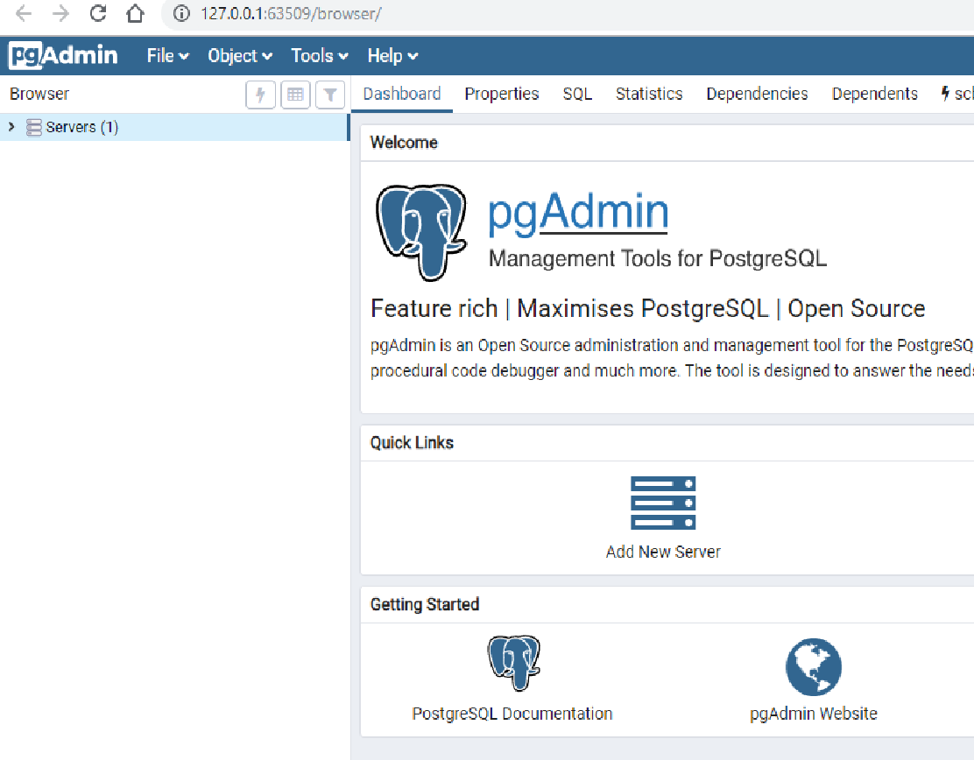
Steps to database server connection
To use PostgreSQL in your machine, you need to install:
PostgreSQL Database Server
A graphical tool to administer and manage the DB. pgAdmin is the most popular tool GUI Tool for PostgreSQL
After successful installation, to launch PostgreSQL go to Start Menu and search pgAdmin 4 and once you select this, it will open pgAdmin homepage.

Slide 28

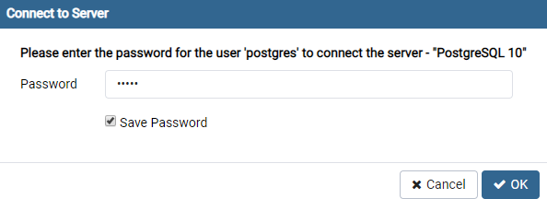
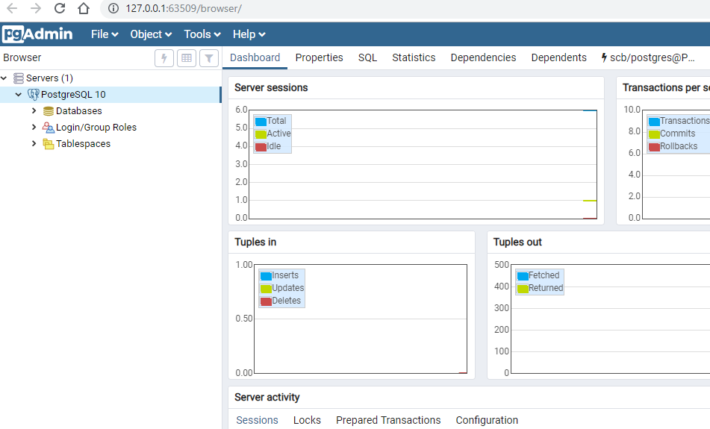
Postgres SQL
Click on Servers > Postgre SQL 10 in
the left tree
Enter super user password set during installation and click OK.
You will see the Dashboard

Slide 29
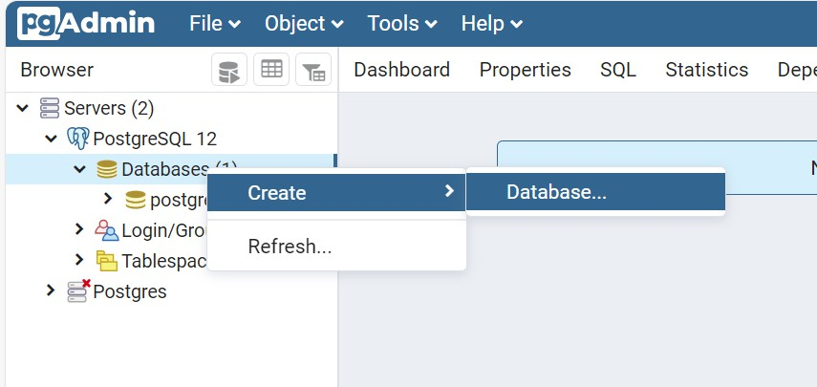
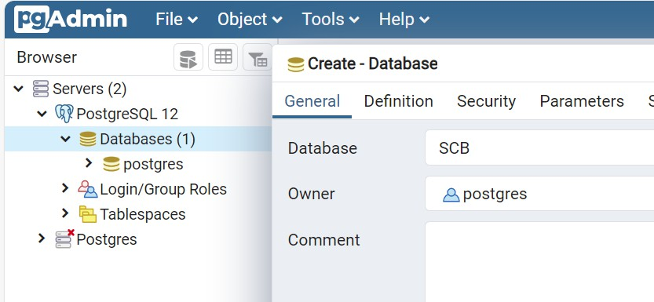
Creating DB
Right click on Databases and click
create->Database
Enter the Database name and click
ok to create DB

Slide 30
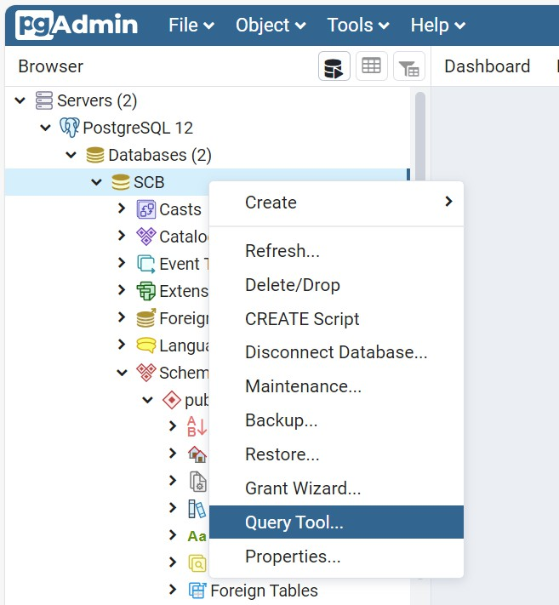
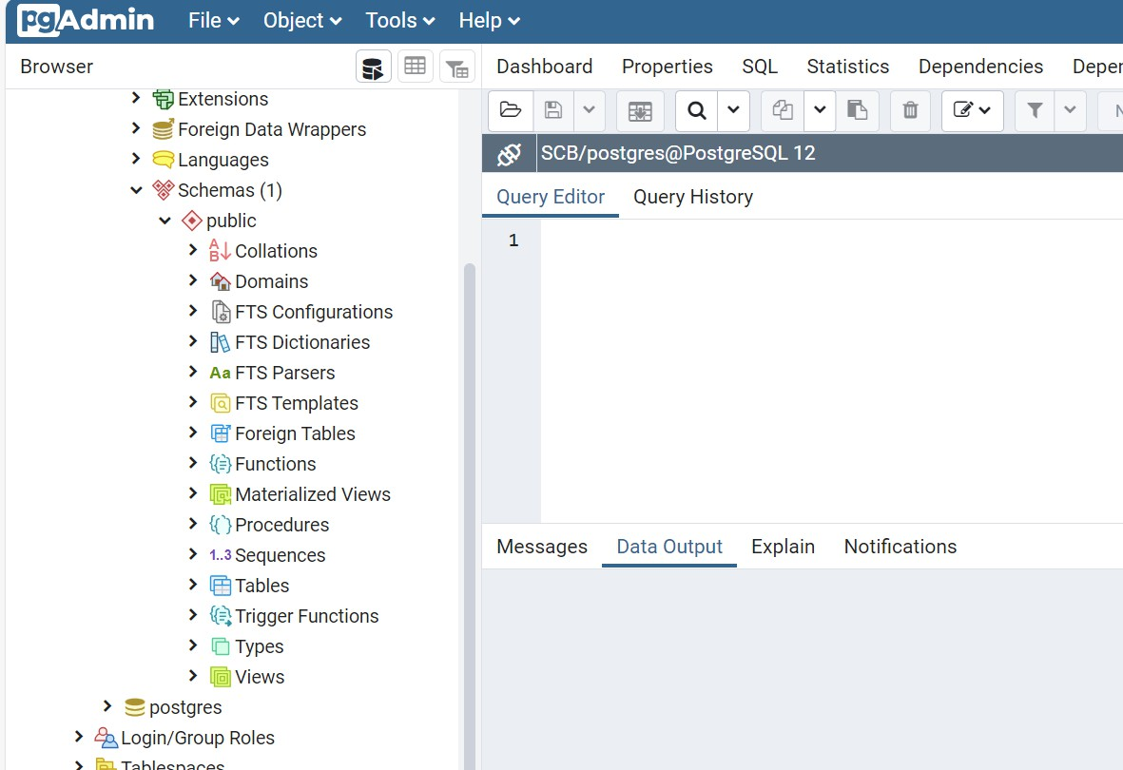
Accessing Query Tool
Right click on the data base and select Query tool to get SQL Query Editor

Slide 31
INTERNAL
SQL

Slide 32

SQL
SQL(Structured Query Language) is a query language which is used to store and retrieve the data from a databases like MySQL, MS Access, SQL Server, Oracle, Sybase, Informix, Postgres etc.
SQL Commands are divided into five broad categories
DDL (Data Definition Language)
DML (Data Manipulation Language)
DQL (Data Query Language)
DCL (Data Control Language)
TCL (Transaction Control Language)

Slide 33
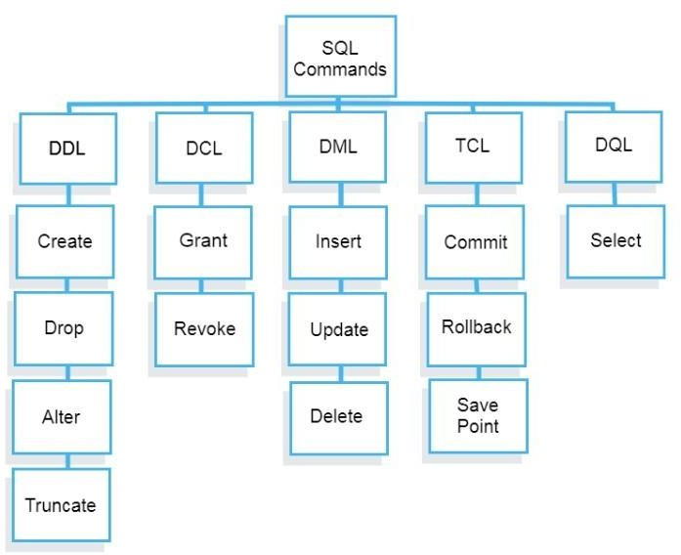
SQL Commands

Slide 34
Constraints
INTERNAL

Slide 35
Constraints
NOT NULL
Ensures that a column cannot have a NULL value
UNIQUE
Ensures that all values in a column are different
PRIMARY KEY
A combination of a NOT NULL and UNIQUE. Uniquely identifies each row in a table
FOREIGN KEY
Prevents actions that would destroy links between tables
CHECK
Ensures that the values in a column satisfies a specific condition

Slide 36
Example
Create table Dept(
Deptno numeric(5) constraint pkey_depno primary key,
Deptname varchar(10) constraint ukey_depname unique constraint nnull_deptname not null);
Create table employee (
Empno numeric(5) constraint pkey primary key,
firstname varchar(15) constraint E_nn1 not null, lastname varchar(20),
age numeric constraint E_chk1 check(age >18 and age < 60) , salary numeric,
city varchar(20) constraint E_nn2 not null,
state varchar(20) constraint E_nn3 not null,
Deptno numeric constraint fkey references Dept(Deptno));

Slide 37
INTERNAL
DDL

Slide 38
DDL
The Data Definition Language is made up of SQL commands that can be used to design the database structure.
It simply handles database schema descriptions and is used to construct and modify the structure of database objects in the database.
It can be used to define the database schema. It allows adding/modifying/deleting the logical structures which contain the data
CREATE : to create a database and its objects
ALTER : alters the structure of the existing databases
DROP : delete objects from the databases
TRUNCATE : remove all records from a table, including memory allocated for the records are removed

Slide 39
DDL - Create
For creating a table, we must define the structure of a table by adding n ames to columns and providing data type and size of data to be stored i n columns.
Syntax:
create table "tablename" ( "column1" "data type",
"column2" "data type",
"column3" "data type“
);
Example:
Create table employee (
Empno numeric(5) constraint pkey primary key, firstname varchar(15) constraint E_nn1 not null,
lastname varchar(20),
age numeric constraint E_chk1 check(age >18 and age < 60) , salary numeric,
address varchar(20) constraint E_nn3 not null,
Deptno numeric constraint fkey references Dept(Deptno));

Slide 40
DDL - Alter
Used to modify or alter the structure of the table
Alter table command is used to:
Add, drop, Modify table columns,
add, drop or modify constraints
Add a Column:
Syntax: Alter Table <Table Name> Add Column_name Column_definition Example: ALTER TABLE employee ADD experience numeric(3);
Modify a column:
Syntax: Alter Table <Table Name> Alter column column_name type column_definition; Example: ALTER TABLE employee alter salary type numeric(15,2);
Syntax: Alter Table <Table Name> rename column <column_name> to <new_name>;
Example: ALTER TABLE employee alter salary type numeric(15,2);

Slide 41
DDL – Alter
INTERNAL
Drop a column:
Syntax: Alter Table <TableName> Drop column column_name Example: ALTER TABLE employee DROP location
Add constraint
Syntax: ALTER TABLE Employee ADD CONSTRAINT Pkey1 PRIMARY KEY (empno);
Example: Alter table Employee add constraint fkey1 foreign key(fkey_deptno) references DEPT(deptno)
Drop Constraints
Syntax: Alter Table Employee Drop constraint pkey2 Example: Alter table Employee drop constraint fkey_deptno

Slide 42
DDL – drop & truncate
Delete:
This statement will delete the structure of the table
The table and its contents will not be recovered after delete
Use this statement carefully
Syntax:
Drop Table tablename
Example :
Drop table Dept
Truncate:
Deletes all the records of the table
Changes are permanent
Syntax:
TRUNCATE Table tablename
Example :
TRUNCATE table dept;

Slide 43
INTERNAL
DML

Slide 44
DML
The SQL commands that deal with manipulating data in a database are classified as DML (Data Manipulation Language), which covers the majority of SQL statements.
It’s the part of the SQL statement that regulates who has access to the data
and the database
It helps us work with data that goes into the database such as
INSERT : Insert data into a Table/Database
UPDATE : Updates existing data within a Table/Database
DELETE : Deletes all records from a database Table/Database

Slide 45
DML - Insert
insert data to the table
With out specifying column names
Specifying column names
Using Select statement
Directly With out specifying column names
insert into employee values ('Luke', 'Duke', 45, 50000.00, 'Hazard Co', 'Georgia’);
Directly With specifying column names
insert into employee(firstname, lastname, age, city, state) values ('Luke', 'Duke', 45,
'Hazard Co', 'Georgia’);
Using Select statement
insert into employee as select * from emp;

Slide 46
DDL – update & delete
Update statement is used to modify the existing records in a table.
Syntax : UPDATE table_name SET column1 = value1, column2 = value2, ...WHERE condition;
Example: update employee set salary=45000 where firstname='Luke'
Delete statement is used to delete the records of a table
Deletes all records:
delete from employee;
Delete records based on Condition:
delete from employee where firstname=‘Luke’

Slide 47
Use case
Create table called accounts with the fields
Attribute | Data | Restriction
accno | Numeric | primary key
empId | Numeric | foreign key references empNo of employee table
balance | numeric | Should be greater than 0
branch | varchar | Not null
Add new column called location with the type of varchar
Rename the column accno to accountNo
Insert data into the accounts table

Slide 48
INTERNAL
DQL

Slide 49
DQL
DQL statements are used to query the data contained in schema
objects.
The DQL Commands' goal is to return a schema relation depending on the query supplied to it.
DQL can be defined as follows: It’s a part of a SQL statement that lets
you get data from a database and put it in order.
The most used code by Data scientists and analysts.
– SELECT: It helps to do data analysis

Slide 50
DQL - Select
Retrieve data from Database
To select all columns from a table
Select * from employee
To select Specific columns from a table
select firstname, lastname, city from employee;
Creating a new name for a column for display purpose
Select firstname as FName, lastname as LName, city from Employee
To select all values of Age column
Select All age from employee
To display distinct values of Age column
Select distinct age from empinfo

Slide 51
Operators
Relational Operators:
– Different Relational operators are = , < , > , <= , >= , != or < >
select last, city, age from empinfo where age > 30;
select last, city, age from empinfo where age <= 30;
select last, city, age from empinfo where first= ‘raj’;
Logical Operators:
– Different Logical operators are AND, OR and NOT
Select * from empinfo where age >20 AND age <80
Select * from empinfo where age <20 or age >60
Select * from empinfo where state in (‘Arizona’ , ‘Michigen’);
Select * from empinfo where age not in(10,20,34,67)

Slide 52
Like and null keyword
Pattern Search with like keyword
% - Matching any character or any numeric of Characters
_ - Matching one character only
Select * from empinfo where first like ‘m%’
Select * from empinfo where first like ‘m%y’;
Select * from empinfo where first like ‘_ _ _ y’
Select * from empinfo where first like ‘_a_’
Null Keyword
– To fetch record whose column is Having NULL, is operator is used.
Select * from empinfo where last IS NULL
Select * from empinfo where last IS NOT NULL

Slide 53
Sorting records
Order by clause is used with Key words ASC and Desc for sorting records
Default sorting key word - ASC
Select * from Employeeinfo order by AGE
Select * from Employeeinfo order by AGE asc
Select * from Employeeinfo order by AGE desc
Select first,last, age, address from employeeinfo order by 3

Slide 54
Aggregate Functions
Used to perform basic mathematical operations like SUM(),AVG(),COUNT(),MIN() and MAX()
Min & Max
Select min(age) from Empinfo Select Max(age) from EmpInfo
Avg & Sum
Select AVG(Age) from empinfo Select SUM(AGE) from empinfo
Count (will not count null values)
Select count(*) from Empinfo Select count(last) from empinfo
Select count( distinc age) from empinfo

Slide 55
Use Case
INTERNAL

Slide 56
Use case
Display all employee details from employee table
Display all employee details in sort it based on the empId.
Display the total salary from employee table.
Display firstname and lastname in single column as empName from employee table
Display empId, salary, location from the employee table from specific location, whose salary greater than ‘n’ and sort based on name.
Display empName, location from employee table whose name starts with ‘s’ in the specific location.

Slide 57
Grouping & Having
INTERNAL

Slide 58
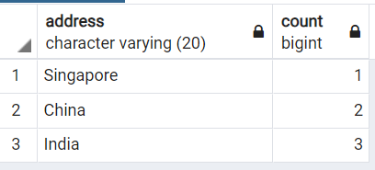
Grouping data
I
The GROUP BY statement groups rows that have the same values into summary rows, like "find the number of customers in each country
The GROUP BY statement is often used with aggregate functions to group the result-set by one or more columns.
Syntax:
SELECT column_name(s) FROM table_name WHERE condition GROUP BY column_name(s)
Example:
select address,count(address) from employee group by address

Slide 59
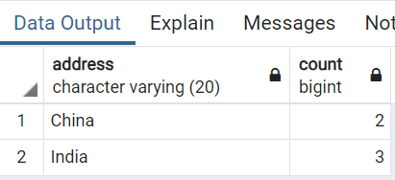
Having
I
The HAVING clause was added to SQL because the WHERE keyword cannot be used with aggregate functions.
Syntax:
SELECT column_name(s) FROM table_name WHERE condition GROUP BY column_name(s) HAVING con
Example:
select address,count(address) from employee group by address having count(address)>=2

Slide 60
Sub Query & Joins
INTERNAL

Slide 61
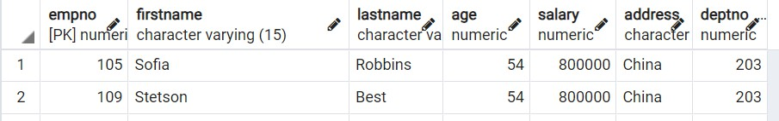
Sub Query
In SQL a Subquery can be simply defined as a query within another query.
In other words we can say that a Subquery is a query that is embedded in WHERE clause of another SQL query.
Syntax:
SELECT column_name FROM table_name WHERE column_name expression operator (
SELECT COLUMN_NAME from TABLE_NAME WHERE ... );
Example:
select * from employee where salary = (select max(salary) from employee)

Slide 62
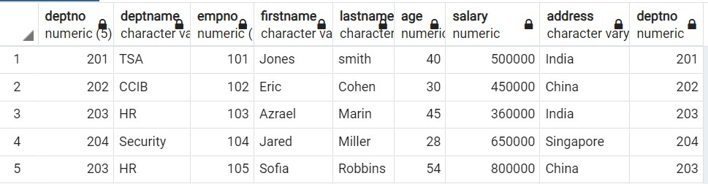
Joins
SQL Join statement is used to combine data or rows from two or more tables based on a common field between them.
Syntax:
SELECT table1.column1,table1.column2,table2.column1,.... FROM table1 JOIN table2
ON table1.matching_column = table2.matching_column;
Example:
select * from dept join employee on dept.deptno = employee.deptno

Slide 63
Types of joins
INNER JOIN
Returns records that have matching values in both tables
LEFT OUTER JOIN
Returns all records from the left table, and the matched records from the right table
RIGHT OUTER JOIN
Returns all records from the right table, and the matched records from the left table
FULL OUTER JOIN
Returns all records when there is a match in either left or right table

Slide 64
Use case
Display the number of employees in each department.
Display employee data who receives highest salary.
Create tables as given below and insert the records.
Display number of customers in each location
Display the number of loans each customer applied

